Slide 1
WEEK 1

Slide 2
Basic Over view of robotics
Microcontroller
ENVIRONMENT
Sensors
Actuator
ADAPTION/
FEEDBACK

Slide 3
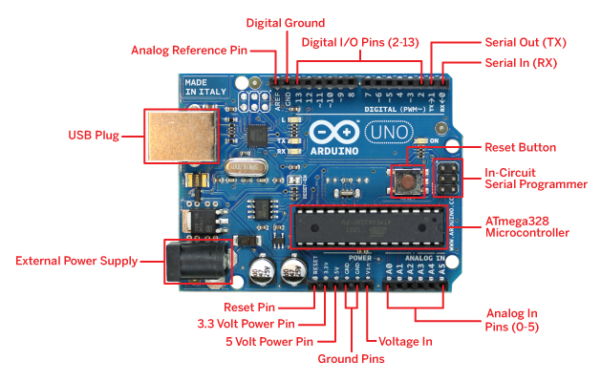
ARDUINO
DOWNLOAD IDE FROM - DOWNLOAD IDE

Slide 4
ARDUINO PROGRAMMING
Link to programming tutorials - tutorials
void setup() - runs only once, used to initialize any variables or to make one time setting to the I/O ports.
void loop() - used if you want the controller to repeat it's task.
analogRead()- used to read the sensor values and interpret it in a way that the controller can understand.(0-1023 )
digitalWrite()-used to either assign a logic high(0n) or logic zero(off) to the Digital pins.
Serial.println()- used primarily to debug.This prints the value on the screen.
*Read about DigitalRead() and analogWrite().

Slide 5
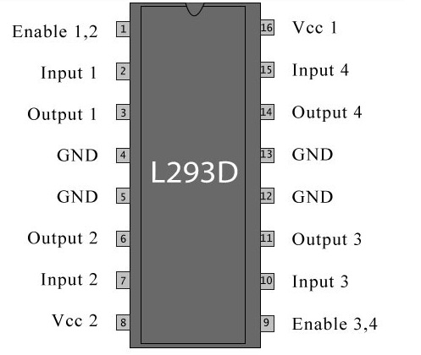
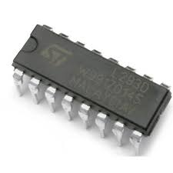
Motor Control
Link to learning material - motor driver

Slide 6
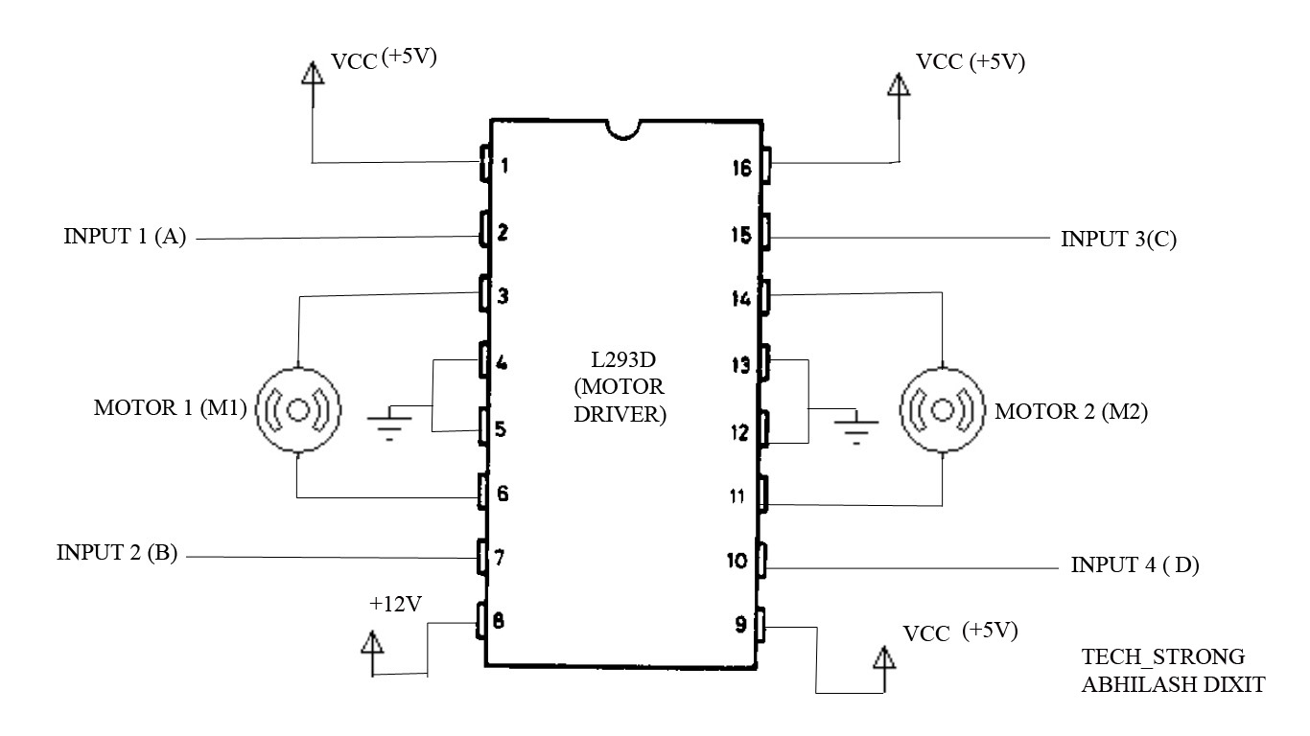
Motor Control ...contd

Slide 7
TASK
To make a closed system using any sensor and any actuator
Motor control tutorials - here
(You wont be evaluated solely on the final output, so just enjoy the process)
Everything about UNO - here

